Slide 1
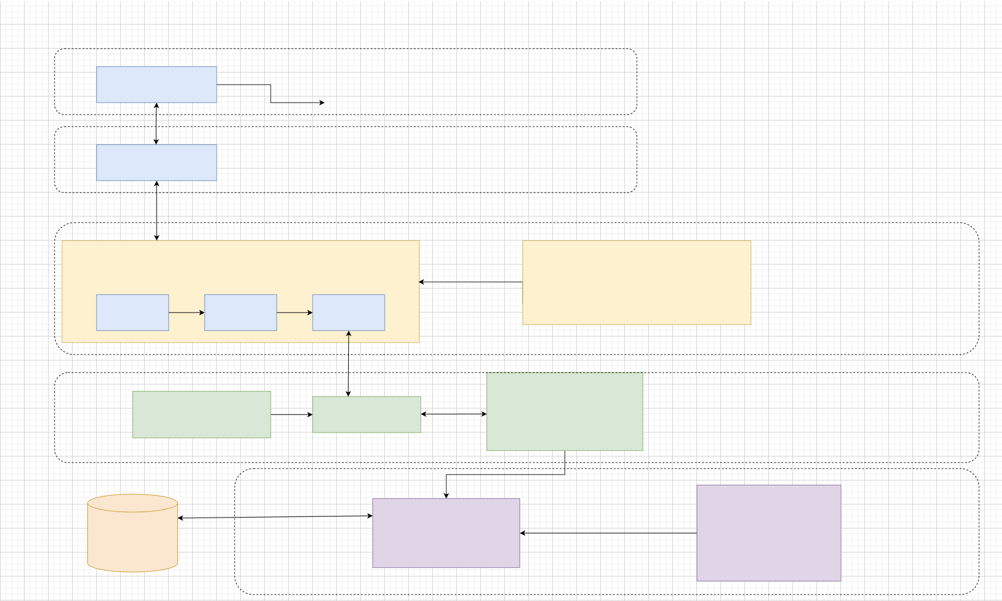
UniPath Application
Type: Application Architecture
View: Logical view
Style: Layered Architecture Pattern
View
View layer
Users
Controller
Controller layer
Encapsulates the application’s business logic
Service layer
Interface
Extends
Implement
src/main/resources
Mapper.xml
CRUD
Persistence
Mapper
DAO layer
Consistent with the attribute value in database
Database
Model
Model layer

Slide 2
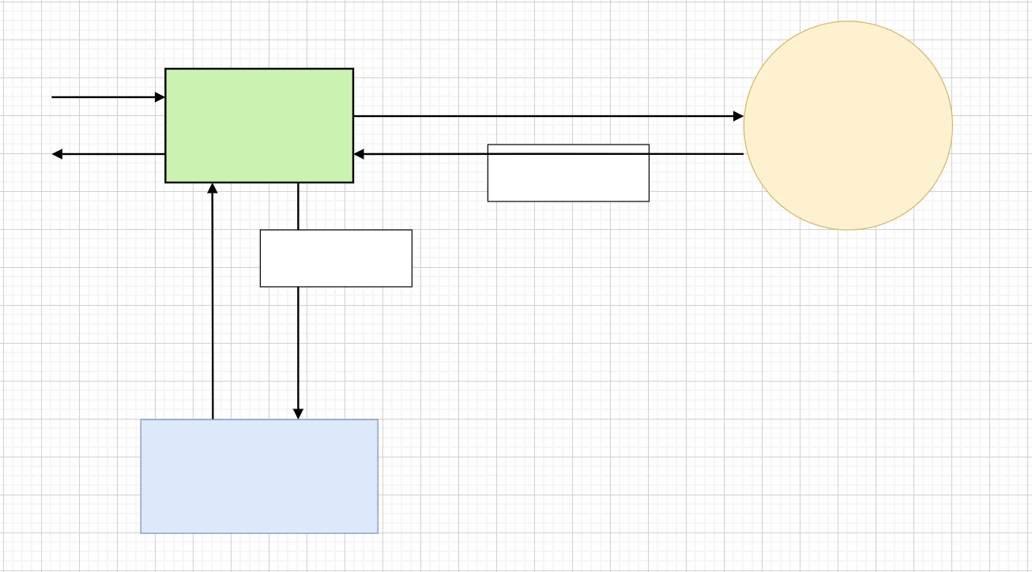
UniPath Application
Type: Application Architecture
View: Process view
Style: Model View Controller
Incoming
Request
Delegate
Request
Front
Controller
Controller
Return
Response
Model
Delegate
rendering
of response
Model
Return
Control
Render
Response
View
Template

Slide 3
